Slide 1
Responsibility, Openness and Science
Louise Bezuidenhout
University of Oxford
Notes:
Introductions
Introduce social science theme

Slide 2
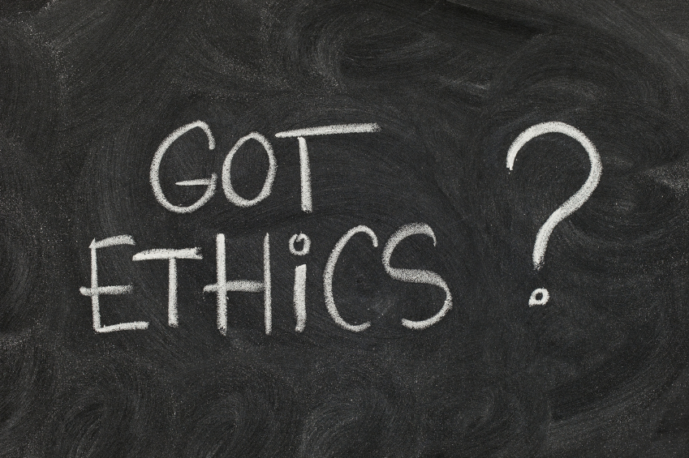
Why Start With A Discussion on Responsibility??
Plan for the morning:
Responsible conduct of research
Open science
Being a responsible, open science citizen
Not just about learning data science … learning responsible data practices
http://dozebuzz.com
Notes:
Ethics is not traditionally the way to start a data science summer school
When most people think of ethics they think of human or animal research, or of people trying to stop you doing research
So why is it in here?
;
We want to convince you about another way of thinking about ethics, about responsibility and openness as core values for science
How they should impact on all aspects of your research and shape the way you work, the way you interact with others and what happens to your data
you’re going to be learning a range of different skills over the coming weeks, learning the basics of becoming a data scientist
This is a great opportunity to start scrutinizing your research and research practices and to think how you can integrate responsibility and openness into your own work
Voltaire

Slide 3
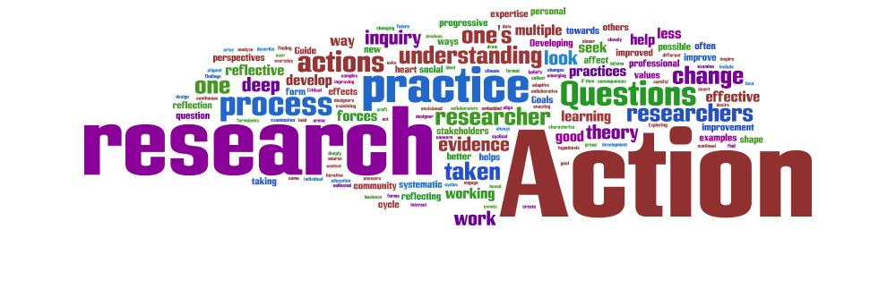
What Do You Think “Responsible Science” Is?
We hear a lot about “responsible science” or being a “responsible scientist”, but what does it mean to you?
As groups take 10 minutes to identify some key activities that describe “responsible science” or “responsible scientists”. Write these down on the post-it notes.
Notes:
We’re going to start off by talking a little about responsibility in research – what you think it is
20 mins
Does it differ by discipline?
Does it matter what methods are used?
Does it change as you progress up the career ladder?

Slide 4
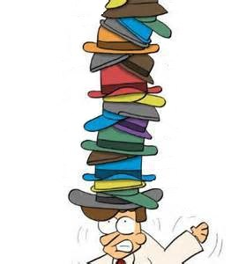
Balancing Multiple Roles as a Scientist
Data producer
Data user and/or collaborator
Author
Employee
Teacher/mentor
Recipient of public funds
Recipient of public trust
Citizen/legally-obligated individual
Notes:
What we can see from the answers is that scientists wear many hats – these all come with different responsibilities

Slide 5
Not just about being
“good at your work”
producing data
Notes:
Most of these responsibilities are commonly synthesised into what is called a responsible conduct of research framework
Outlines the different areas of scientific research that raise ethical concerns
RCR frameworks highlight that being a responsible researcher is not just about being good at your work, it is about working in a specific manner that is ethical and has integrity
Talk about different areas
Expectations placed on scientists, codes of conduct etc

Slide 6
RCR as a Collaborative Endeavour
Notes:
It is important to recognize that effective RCR is a collaboration between individual scientists and their environment
Indeed, no one expects you to do it alone
While once in a while you may have a bad apple, it is usually the case that cases of misconduct occur when the environment is not supportive of responsible conduct
Thus, the environment needs to support the scientist for responsible conduct by providing training, resources, guidance and infrastructures

Slide 7
Changing The Practices, Environments and Practitioners
Individual responsibility
Compliance
Active engagement
Institutions
Create supportive infrastructures
Monitor and mediate
National/international systems
International science community
Monitoring
Fostering culture

Slide 8
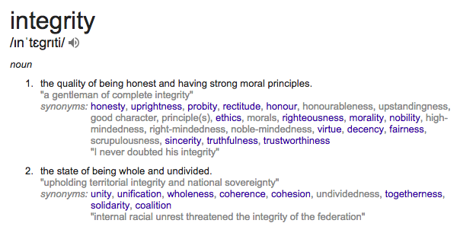
Key Traits of “Responsibility” Discussions
Practice of scientific investigation with integrity
Notes:
Using a framework like RCR helps us to understand how highly different practices, like treatment of human subjects, criteria for authorship of articles and the disposal of laboratory waste all form part of the same, bigger picture
All of these different RCR activities enable individual scientists to practice scientific investivation with integrity

Slide 9
Key Ethical Norms
Awareness and application of professional norms and ethical principles in all areas relating to scientific research
Beneficence
Non-maleficence (FFP, harm)
Accountability
Transparency
Care
Collegiality

Slide 10
Responsible Conduct of Research
Promotes the idea of a ”science citizenship” to the global science community
Citizenship is a give and take
Benefits to enjoy
Responsibilities to assume
Support and grow culture instead of
just living in it
http://www.evilenglish.net/the-big-picture/
Notes:
Like being a citizen of a country – you are still a citizen when you are at work, or brushing your teeth, or playing with your children
Your cultural values influence everything that you do and the way that you do it
Similarly for RCR – think of it as a citizenship to the global science community
The values of RCR provide a lens through which you conduct all your different activities – all the different hats that you wear
Give and take

Slide 11
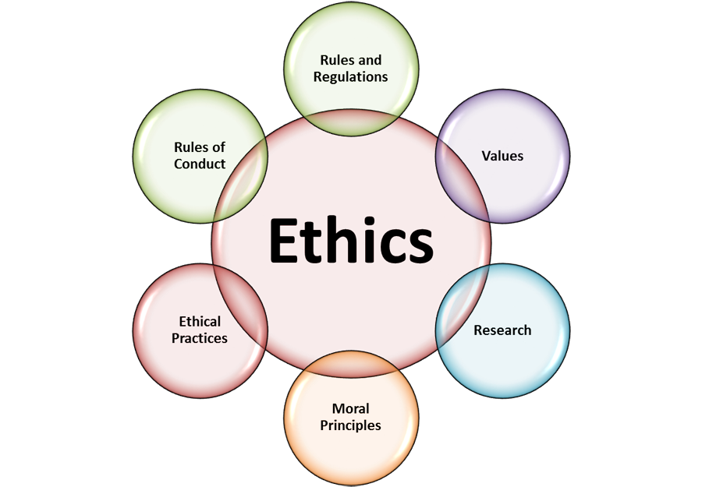
More holistic views on ethics
Is what I’m doing living up to these ideals?
Can I make things better?

Slide 12
Cultures of Responsibility
Produce verifiable and re-usable data
Protect scientists and societies from harm
Enable collaboration
Ensure investments (financial, trust, time etc) are recompensed
Embeds science within cultural/social priorities
Notes:
Ultimate aim of RCR is to produce cultures of responsibility that govern how scientific research is done
In addition to safeguarding against harm, such cultures have considerable benefits
Focusing on responsibility and justice produces re-usable data and data sharing
Collegiality and trust enable collaboration

Slide 13
Increasingly Digital
Amount and types of data being produced
Practices of science
What constitutes “good practice”
How science “citizenship” is understood
Notes:
But things are changing fast
Digital revolution is changing the way science is conducted

Slide 14
The Limitless Possibilities of an Open World
Notes:
The rapid advances in ICTs seem to have created a situation in which the world is an oyster for science
More ways to gather data, more ways to analyse it,
However, the rapidly expanding online environment is placing a lot of strain on scientific structures, as people start to question how responsible research is conducted in an increasingly digital setting
Losing some of the traditional cecks and balances

Slide 15
Translating Science Citizenship into a Digital Age
Understandings of RCR in a digital age continue to evolve
Extension of existing discussion, but also new areas for concern
Opportunity to share vs loss of control
Increase benefits of research for public vs possible harms
(Un)Intended marginalizations
Data recombination, re-use

Slide 16
A New Ethos for Scientific Research
How can the evolving power of digital technologies be harnessed to uphold the principles of scientific citizenship?
How can practices and structures of scientific research be adapted to ensure that research benefits the most number of people?
How can the culture of science be adapted to support this evolution?
What is the role of the individual scientist in this revolution?

Slide 17
http://skewsme.com/
Notes:
How can everyone adapt?
Infrastructures supporting the online environment
Scientists as spiders curating the web

Slide 18
Responsible Conduct of Research in a Digital Age?
What are some of the challenges of conducting responsible research in an increasingly digital environment?
As groups take 10 - 15 minutes to identify some key challenges. Write these down on post-its.

Slide 19
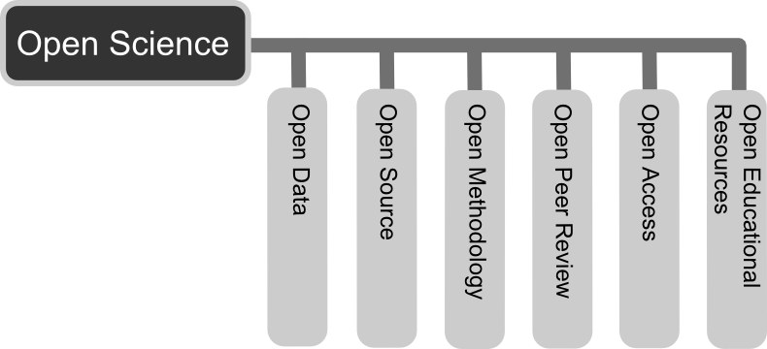
The Open Science Movement
Justice
Notes:
Expanding the way we think about responsible conduct of research
Focus on justice
HGP – products of scientific research a public asset that should be a shared resource
Reaction to the increasing cost of accessing published research
Reaction to proprietary control of data, software, literature

Slide 20
Open Science
The products of scientific research should be freely available to everyone to use and republish as they wish, without restrictions from copyright, patents or other mechanisms of control
Open Science includes activities that:
facilitate resource sharing
improve awareness of sharing
create linkages between resources
advocate for removal of financial barriers

Slide 21
Ethics of Openness
Openness as …
The just distribution of resources (public funds and research products)
A way of maximizing the benefits of research
A safeguard against possible harms arising from research
As a means of improving accountability and transparency
An enactment of collegiality
The obvious extension of the norms of science (CUDOS)

Slide 22
A Range of Different Activities
Legal/economic
Educational
Advocacy
Standardization and standard setting
Notes:
Cultural movement but also very specific and technical activities

Slide 23
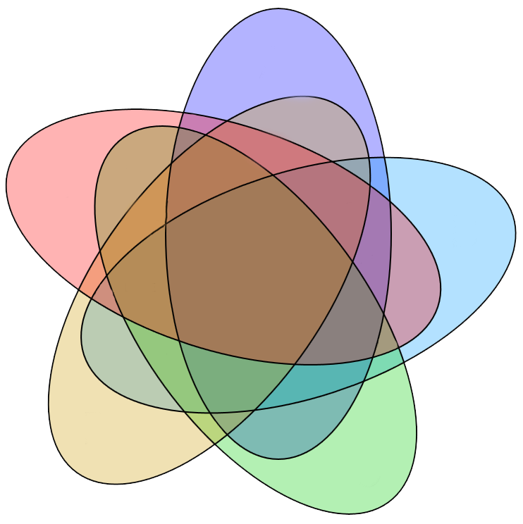
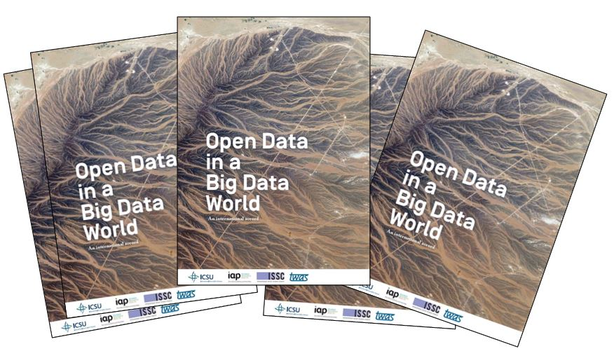
Creating Open Environments
Institutional repositories
Resources for ICTs
Role of libraries
Physical (lab)
environment
Expectations of sharing
Public engagement
Ethics
Cultural
enviro
Work
culture
Open and
international
research
practices
RDM
FAIR
Data sharing policies
Sharing tools
Online
environment
Bureaucratic
enviro
Notes:
Like RCR, openness needs to be thought of in multiple dimensions
Commitment to openness affects all different aspects of research practices
Open science movements heavily involved in all of these

Slide 24
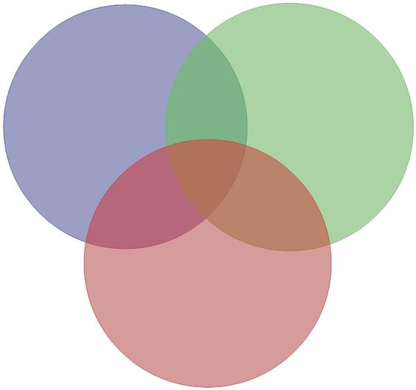
Openness in daily research practices
Motivations of individual researcher
Support from environment
Characteristics of the data and research
Values and policy
Notes:
Each person can make a difference
Obligation as well as an opportunity

Slide 25
Multiple Roles and Openness
Data producer
Data user and/or collaborator
Author
Employee
Teacher/mentor
Recipient of public funds
Recipient of public trust
Citizen/legally-obligated individual
Notes:
What we can see from the answers is that scientists wear many hats – these all come with different responsibilities

Slide 26
Steps to Openness
Ethical: why is openness important?
Yes, I understand … sign me up!
Understand the legal environment
I know when I shouldn’t be sharing data
I know what true openness looks like (predatory journals)
I know that openness is not the same as restriction-less
Scrutinize daily research practices
What could you be making more open – data, publications, methods etc?
Are there key challenges that you need to consider?

Slide 27
Steps to Openness
4. What tools are available online that can help your quest for openness?
1. Practical tools, support systems, communities of practice
5. Understanding the big picture as well as the little picture
1. How openness is changing science
2. How the infrastructures of this changing landscape need to be scrutinized
3. How my actions contribute to this big picture
6. Becoming an advocate for openness within your own environment
1. Being a champion amongst peers and students
2. Advocating for national change

Slide 28
Open Science and Data Science
Group discussion
What activities are you currently engaged in that promote openness in research?
Think about your diverse roles as diverse roles as data creator, user, infrastructure builder, teacher and communicator
What are the particular challenges in your discipline/research environment/country to being an open, responsible researcher?
What areas of openness would you like to improve in? Do you have an idea of how you could achieve this? What areas do you need help with?
Notes:
Mindmap
Not just about learning to be a data scientist, it’s about learning to be an open, global, responsible data scientist :)

Slide 29
Tools for Responsible, Open Science Citizenship
Data science
Practical skills
Norms and values
- infraethics
Data management
Norms and values (FAIR)
Practical tools - RDM
Authorship
ORCID
Journals and licensing
Data use
- Finding and using data
- Data re-use and attribution
Ethics and responsibility
- Areas for activity
Openness, sharing, justice, beneficence

Slide 30
Plan for Open Science Training
August 9th
8:30 - 10:30 Survey results (last year’s slides as example) 20mins
Intro to RDM 45 mins + questions
Discussion exercise on FAIR checklist [DCC] 40mins
10:30 - 11:00 Coffee
11:00 - 13:00 ORCIDs, orientation to rstudio [GAIL]
14:00 - 15:00 intro to DMPs - close on looking at a DMP note what is good and how to improve it [DCC]
15:00 - 16:00 markdown of a DMP (case study of predatory / reputable OA journals) [GAIL]
August 10th
8:30-10:30 markdown of a DMP continued and plotting journal licences [GAIL]
10:30-11:00 coffee
11:00-13:00 co-taught session on data sharing (c.30-45 min each):
1. Review derivative DOAJ seal dataset and re3data to select repo - see final slide of DMP
2. Gail to do deposit (see if we can use Caltech training repository)
3. Louise to close with discussion on licensing and ethics
14:00 - 15:30 Finish document in markdown, sync to ORCID, publish to GitHub [GAIL]
15:30 - 16:30 Broad discussion on being an open science citizen and FAIR practices [LOUISE]

